Slide 1


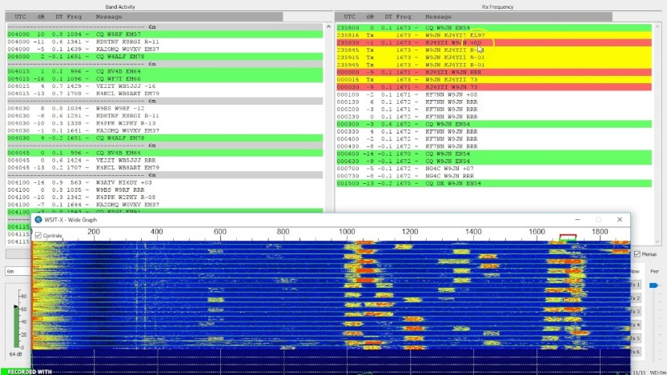
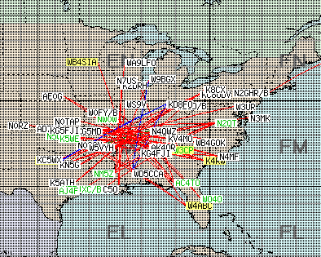
The Road to 6 Meters
“It’s The Magic Band”
By Christian Bravo - W4ALF

Slide 2
Why 6 Meters? “Any time I went on that band I heard nothing…”
Open to all classes of license, T,G,E
Can use same equipment you may already have
Antennas are small at 9 foot for dipole, or use existing HF antennas!
Gain Antennas or yagis are easy to homebrew.
When the band is open, can make contacts with minimal equipment and power. You Have to Know When to be ON!
Can be a challenge as propagation patterns can be unpredictable
Learn some new modes FT8 or MSK144 for Meteor Scatter
You can get awards such as ARRL VUCC - 100 grids confirmed

Slide 3
What are those letters and numbers I hear sent instead of a signal report??
Maidenhead Locator System
Geographic coordinate system used by Hams
Maidenhead Locator System adopted in the 80’s
Fields: divides the globe 324 “fields” [indicated by first pair]
Squares: each of these squares represents 1° of latitude by 2° of longitude. 100 “squares” in each Field. [indicated by second pair]
For Example: I am EM78qw – EM is the Field /78 is the square /qw is the sub square. Another 2 characters can be added for precision.
Usually only the first four characters of your grid square are used e.g. “my grid is EM78”

Slide 4
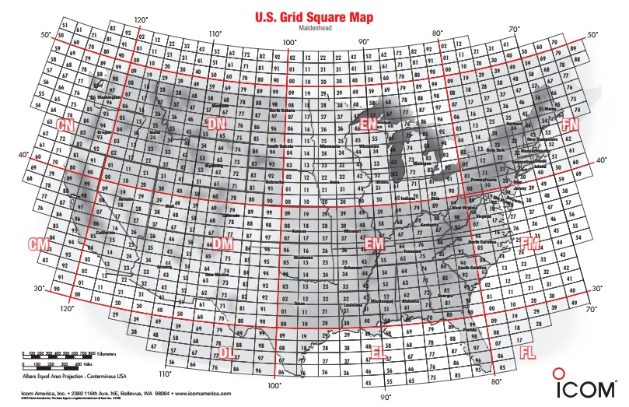
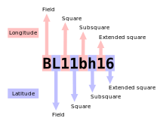

Slide 5
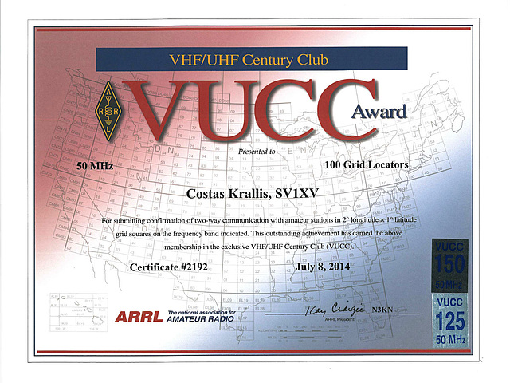
ARRL VUCC 50mhz
Award for 100 grid squares confirmed.
Good goal to work towards when learning about 6 Meters.

Slide 6
What Frequencies? What Modes?
Beacons |  |  | 50.060-50.080 mhz
CW |  |  | 50.090 mhz
national calling freq |  |  | 50.125mhz
ssb qsos |  |  | 50.100-200 mhz
dx calling frequency |  |  | 50.110 mhz
ft8 |  |  | 50.313 mhz
jt65 |  |  | 50.310 mhz
msk144 |  |  | 50.260 mhz
Mode | QSO Count | %
6M CW | 82 | 23%
6M Data | 169 | 48%
6M PH | 99 | 28%
Grand Total | 350 | 100.00%

Slide 7
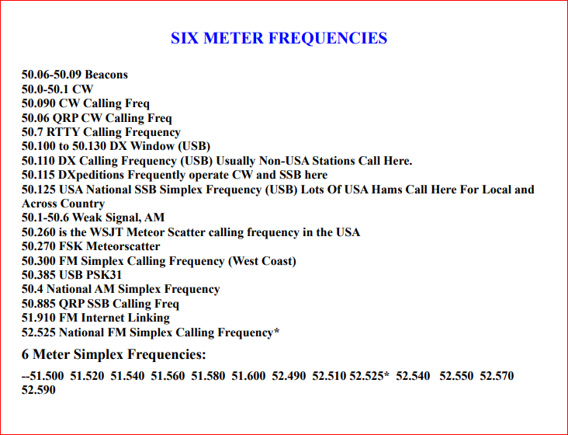

Slide 8
Most Common 6m Propagation Types
E-sporadic “Es” – Bulk of your activity will most likely be this!
Tropo/Tropospheric Ducting
Auroral
Back Scatter
Meteor Scatter
Others: Auroral-Es/EME/F2/TEP –Transequatorial, etc…

Slide 9
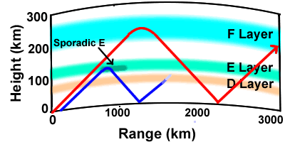
Sporadic E Propagation – a.k.a Es
What is Sporadic E?
Sporadic-E (also known as Es) propagation is probably familiar to many low-band operators as the summertime "short skip" on 10 meters. It is also responsible for most of the long-distance (out to 1200mi) contacts on the 6-meter band.
Ionospheric E-layer reflection caused by small patches of unusually dense ionization. These sporadic E-layer "clouds" appear unpredictably, but they are most common over the US and southern Canada during the daylight hours of late spring and summer.
May thru August peaking in June July
Supports single hops or multihops
Unknown Cause
Long Distance Comm past 1,200mi has various theories

Slide 10
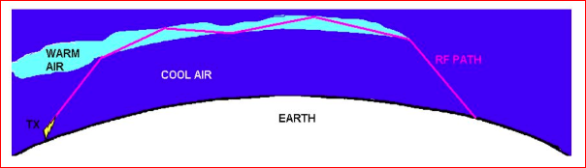
Tropospheric Ducting aka “Tropo”
Temperature Inversions in the Troposphere (up to about 10km) cause refractions of Radio waves. Layers of opposing warm and cool air create a “ducting” effect.
The Refractive Indices of the different temp layers causes signals to bounce thru “ducts”, typically 500mi or so, but can be longer distances. 2M FM also uses this propagation mode when open and can travel up to several hundred miles.
Can be along storm fronts, coastal areas, over bodies of water.. E.g. California to Hawaii. Certain areas of the world can have more predictable propagation paths.

Slide 11
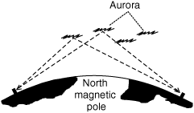
Auroral Propagation
Propagation where radio waves are reflected by Aurora Borealis. Aurora happens when solar wind affects areas over the north magnetic polar regions and causes ionization
Mostly a Northern hemisphere prop type with distances up to 1400mi with no hops
Signal may have fluttering and signature “Raspy” sounding modulation.
If you have a steerable antenna, point it North.
https://www.youtube.com/watch?v=T80GMIhJNag

Slide 12
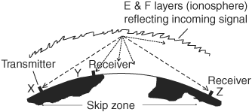
Back Scatter
Propagation where some radio waves are reflected back into the skip zone although signals are much weaker.
“Cathedral like” and “Barrel-like” sounding quality to voice modulation
Allows for communication in the skip zone.
Directional antennas and power are helpful since the signal reflected back is much weaker.
https://www.youtube.com/watch?v=EGs3YQGt-II

Slide 13
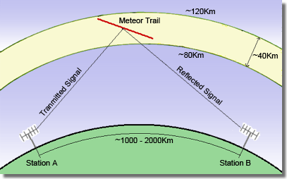
Meteor Scatter
Propagation where radio waves are reflected ionization trails of meteors entering earth’s atmosphere. Thousands of meteors a day enter our atmosphere.
Trails of ionization last usually seconds or fractions of a second. Qsos tend to be in a very regimented pattern and may take many repeats to complete qso. Bounce is called a “ping” aka ping jockeys!
Digital Modes such as MSK144 automates repeated attempts to finish QSO. WSJTX software has this mode. Range about 1200mi.
Best at height of Meteor activity, example is in August with Perseids. 12AM to about dawn is optimal time. May thru Sept height of meteor season.
https://www.pingjockey.net/cgi-bin/pingtalk
Real time chat for Skeds
Used on various bands 2M,6M,10M
Used by Military “COMET”, SNOTEL, NWS AK

Slide 14
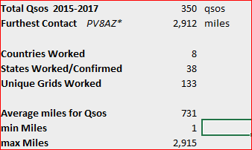
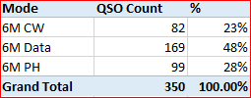
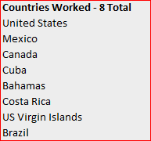
W4ALF STATS ON 6 Meters
*worked but unconfirmed…
Data Modes: JT65, FT8 and 1 RTTY

Slide 15
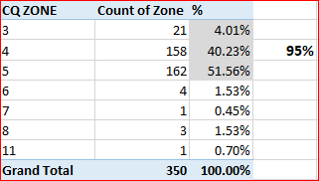
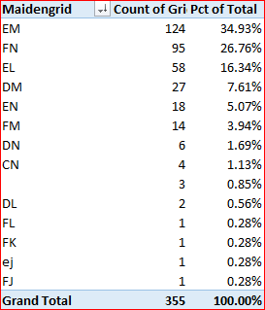
W4ALF STATS ON 6 Meters

Slide 16
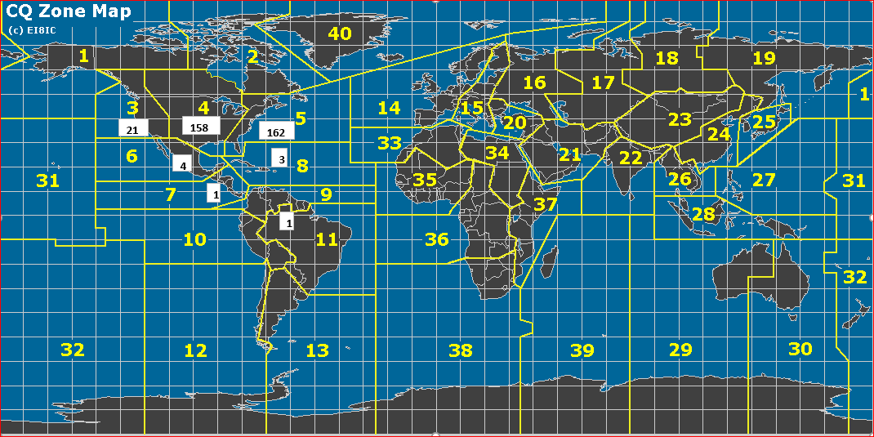

Slide 17
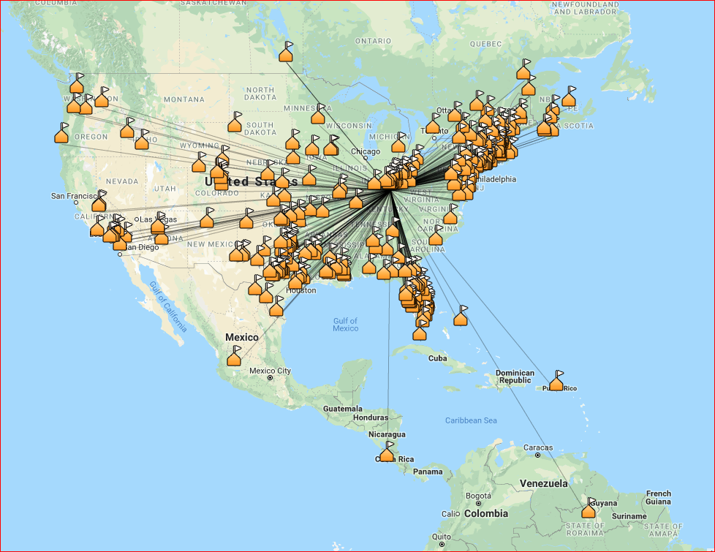

Slide 18
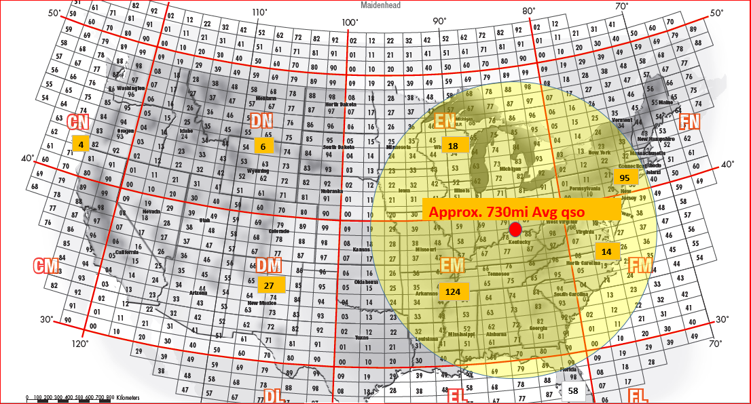

Slide 19
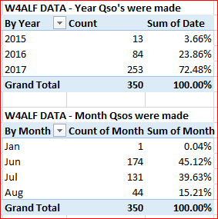
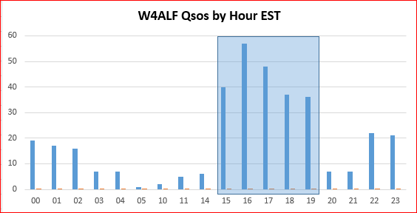
W4ALF STATS ON 6 Meters – When?

Slide 20
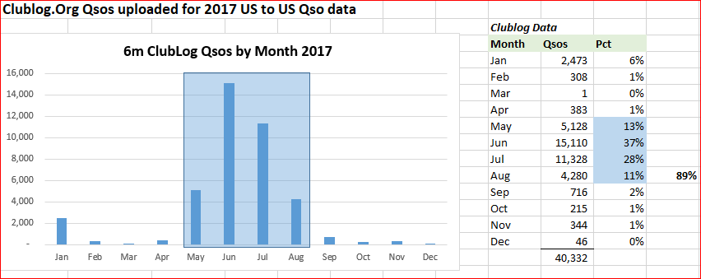
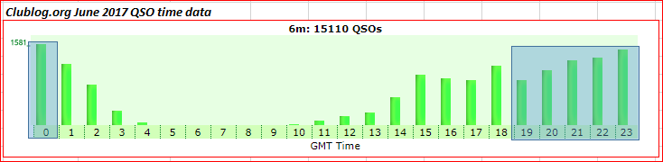
Clublog.org STATS ON 6 Meters – When?

Slide 21

How do I know when to be on?
www.dxmaps.com – has real-time maps of qso’s and aggregates from cluster, RBN, WSPR, PSKreporter, etc
Beacons on air: 50.060mhz to 50.080mhz
Check DX Spotting networks e.g. http://www.dxsummit.fi/#/ also Reverse Beacon Network
Be on the air for Major VHF Contests. Sometimes propagation cooperates.
ARRL Field Day in June
ARRL VHF Contest in June and January
Just get on the air and check near the calling frequencies??
Maybe just get on air??

Slide 22
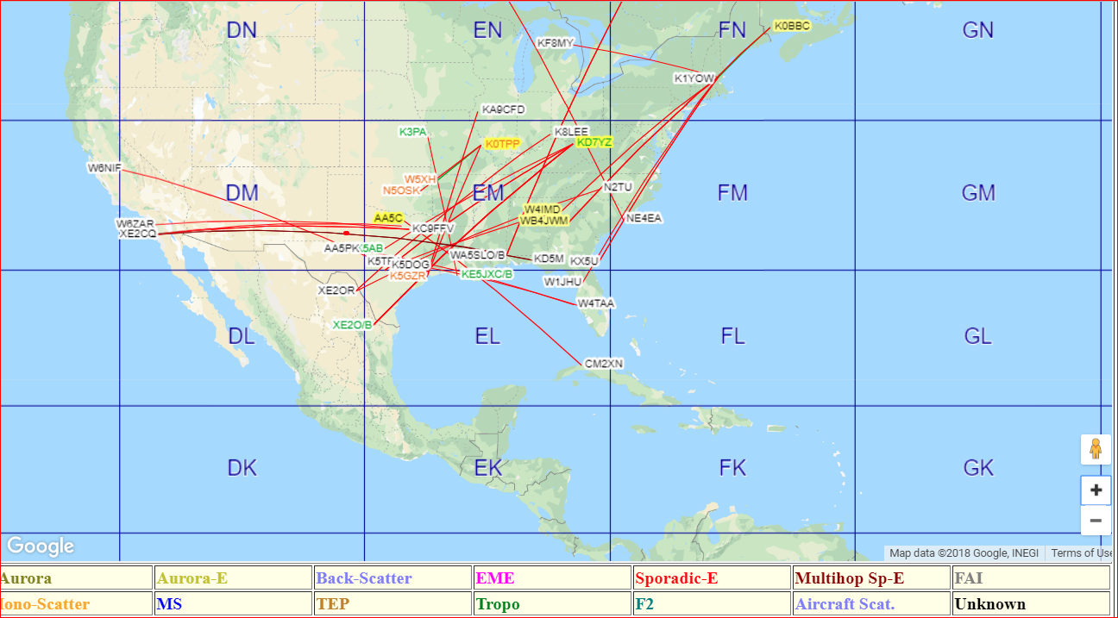
DxMaps.com is your friend…
https://www.dxmaps.com/spots/mapg.php

Slide 23
FT8 & WSJT-X Software
FT8 is a weak signal prop digital mode with a 8-frequency shift keying format
Uses FEC - LDPC (174,87)
Bandwidth is 50hz
Began to be used heavily on 6M last season 2017.
Slightly less sensitive [-24db~ vs -26db jt65] than JT65 but much shorter tx time per interval 15sec vs 45sec.
Locked in QSO pattern that sends SNR in db and Grid Square.
Time sequenced in 15 sec intervals [12.45sec].
WSJT-X software also does JT6M, FSK441, JT9, JT65, MSK144, etc.
Use your same set up for other digital modes, just need to download the WSJT-X software
FT8 requires accurate time synchronization on the PC that is running the software. The precision required is best achieved using a specialized time sync application. These can be found online.
An auto-sequencing feature offers the option to respond automatically to the first decoded reply to your CQ.
USE IT ON ALL THE BANDS VHF/HF and LOW BANDS!!

Slide 24
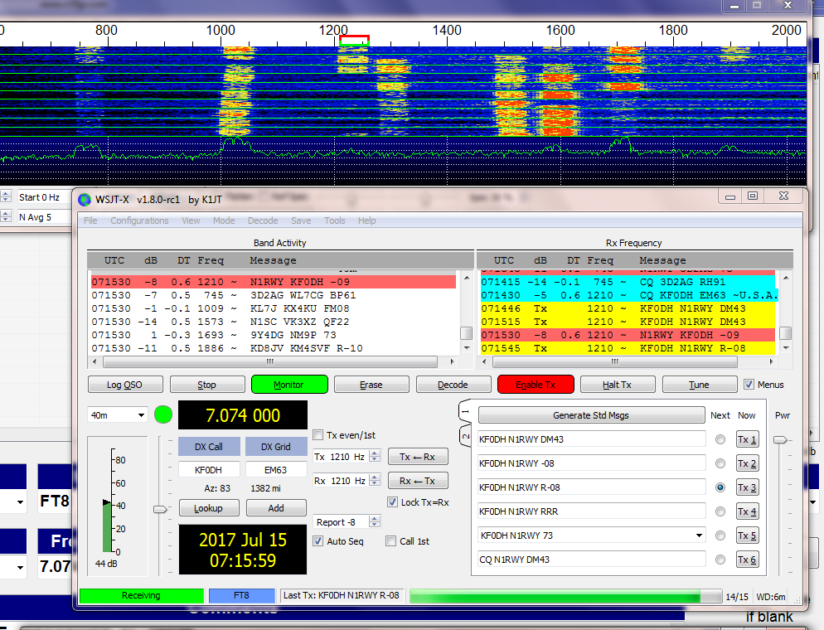
FT8 & WSJT-X Software

Slide 25
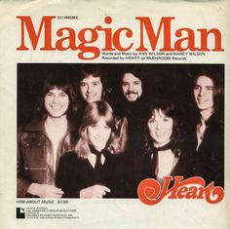
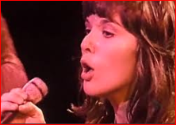
The End – Go operate 6M!
Open mainly with Es season May thru August with minor opening Dec/Jan
Use same equipment you already have
Try out FT8, this will serve you well on other bands, I love it for 80M DX!
Learn new propagation modes
Chase new awards VUCC, WAS 6M, Fred Fish Memorial, etc.
Gives you new focus of activity during lows of solar cycle
Learn new tools to monitor propagation www.dxmaps.com
Try 6m during Field day or ARRL VHF Contests
Try, Try, Try to understand – It’s the MAGIC BAND!

